Slide 1
Online Role-based training resources: Microsoft Learn https://docs.microsoft.com/en-us/learn/

Slide 2
Module 4: Design a Data Model In Power BI

Slide 3
Learning Objectives
You will learn the following concepts:
Data Modeling
Working with Tables
Dimensions and Hierarchies
Notes:
By the end of this module, you’ll be able to:
Create and use Dashboards and understand their purpose.
Create Real-time dashboards
Enhancing existing dashboards

Slide 4
Module Agenda
Introduction to Data Modeling
Working with Tables
Dimensions and Hierarchies

Slide 5
Lesson 1: Introduction to Data Modeling

Slide 6
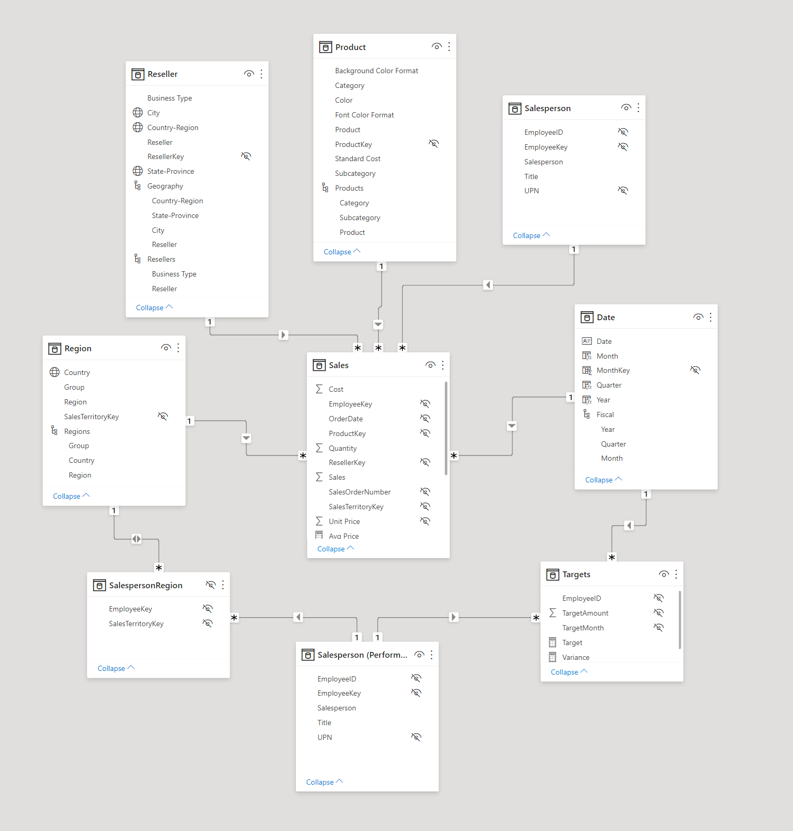
Introduction to Dashboards
Benefits of a good data model:
Accurate reports.
Faster data exploration.
Simpler aggregations.
Easier to maintain.
Notes:
Creating a great data model is one of the most important tasks that a data analyst can perform in Microsoft Power BI. By doing this job well, you help make it easier for people to understand your data, which will make building valuable Power BI reports easier for them and for you.
A good data model offers the following benefits:
Data exploration is faster.
Aggregations are simpler to build.
Reports are more accurate.
Writing reports takes less time.
Reports are easier to maintain in the future.
Providing set rules for what makes a good data model is difficult because all data is different, and the usage of that data varies. Generally, a smaller data model is better because it will perform faster and will be simpler to use. However, defining what a smaller data model entails is equally as problematic because it's a heuristic and subjective concept.
Power BI allows relationships to be built from tables with different data sources, a powerful function that enables you to pull one table from Microsoft Excel and another from a relational database. You would then create the relationship between those two tables and treat them as a unified dataset.

Slide 7
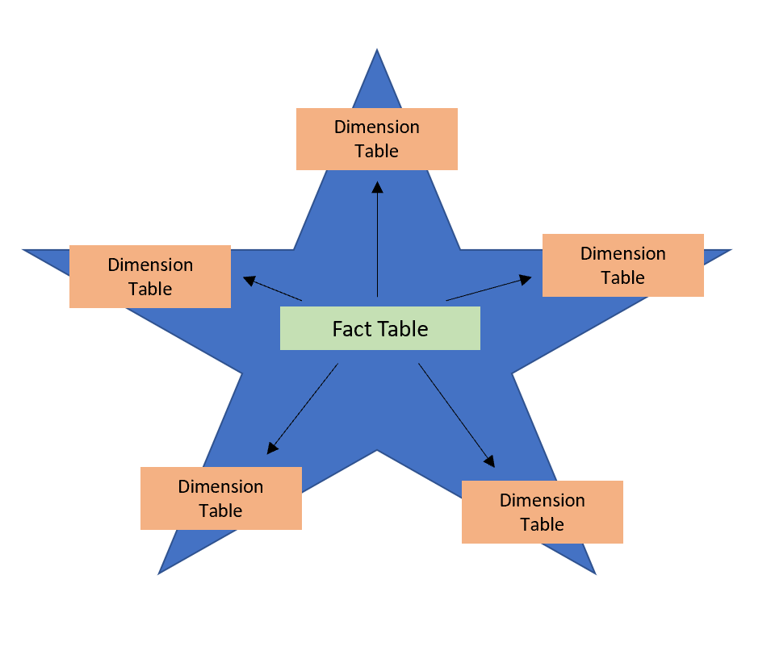
Star Schemas
Tables are classified as dimension or fact tables:
Dimension: Describes business entities.
Fact: Store observations or events.
Notes:
You can design a star schema to simplify your data. It's not the only way to simplify your data, but it is a popular method; therefore, every Power BI data analyst should understand it. In a star schema, each table within your dataset is defined as a dimension or a fact table.
Star schema overview:
Star Schema: Requires modelers to classify their model tables as either dimension or fact.
Dimension: Describe business entities—the things you model. Entities can include products, people, places, and concepts including time itself
Fact: Store observations or events, and can be sales orders, stock balances, exchange rates, temperatures, etc.
A fact table contains dimension key columns that relate to dimension tables, and numeric measure columns. The dimension key columns determine the dimensionality of a fact table, while the dimension key values determine the granularity of a fact table.
Fact tables are usually much larger than dimension tables because numerous events occur in fact tables, such as individual sales. Dimension tables are typically smaller because you are limited to the number of items that you can filter and group on. For instance, a year contains only so many months, and the United States is comprised of only a certain number of states.

Slide 8
Review Questions
Q01 – The two types of tables in a star schema are what?
A01 – Dimension and Fact tables.
Q02 – What is the difference between a fact table and a dimension table?
A02 – Fact tables store observations or events while dimension tables contain information about specific entities within the data.

Slide 9
Lesson 2: Working with Tables

Slide 10
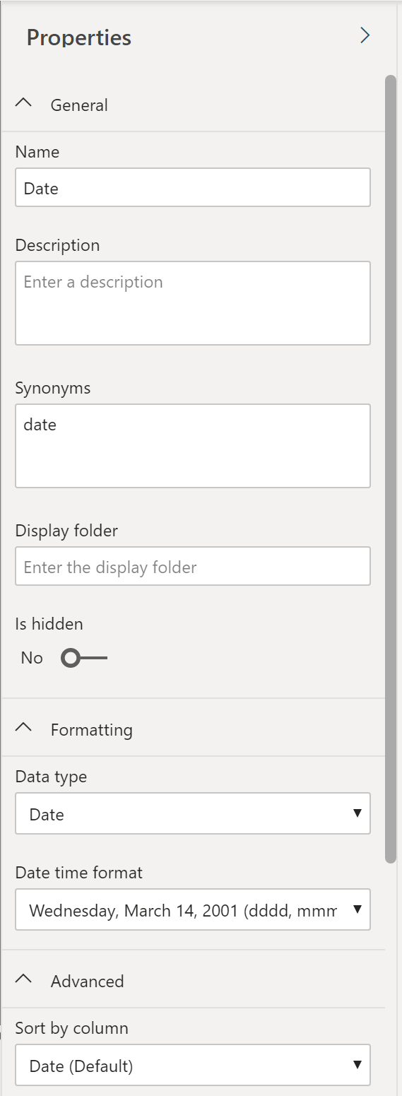
Configure Table and Column Properties
Before working on reports, ensure your model and table structure are simplified.
A simple table structure will be easy to navigate.
Notes:
When users see fewer tables, they will enjoy using your data model considerably more. For example, suppose you've imported dozens of tables from many data sources and now the visual appears disorderly. In this case, you need to ensure that, before you begin working on building reports, your data model and table structure are simplified.
A simple table structure will:
Be simple to navigate because of column and table properties that are specific and user-friendly.
Have merged or appended tables to simplify the tables within your data structure.
Have good-quality relationships between tables that make sense.
Configuring table and column properties helps working with a data model much easier and more efficient.
The Model view in Power BI desktop provides many options within the column properties that you can view or update. A simple method to get to this menu to update the tables and fields is by Ctrl+clicking or Shift+clicking items on this page.
The General tab:
Edit the name and description of the column.
Add synonyms that can be used to identify the column when you are using the Q&A feature.
Add a column into a folder to further organize the table structure.
Hide or show the column.
The Formatting tab:
Change data type.
Format the date.
The Advanced tab:
Sort by a specific column.
Assign a specific category to the data.
Summarize the data.
Determine if the column or table contains null values.

Slide 11
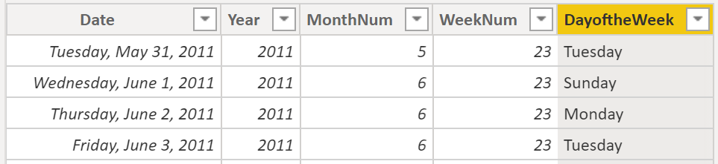
Create a Dates Table
Standardize on date formats and ranges that meet company requirements.
Notes:
During report creation in Power BI, a common business requirement is to make calculations based on date and time. If you want to analyze anything over time, there is likely no more important table to create for any Power BI model than a date table. Organizations want to know how their business is doing over months, quarters, fiscal years, and so on. For this reason, it is crucial that these time-oriented values are formatted correctly. Power BI autodetects for date columns and tables; however, situations can occur where you will need to take extra steps to get the dates in the format that your organization requires.
For example, suppose that you are developing reports for the Sales team at your organization. The database contains tables for sales, orders, products, and more. You notice that many of these tables, including Sales and Orders, contain their own date columns, as shown by the ShipDate and OrderDate columns in the Sales and Orders tables. You are tasked with developing a table of the total sales and orders by year and month. How can you build a visual with multiple tables, each referencing their own date columns?
To solve this problem, you can create a common date table that can be used by multiple tables.
Ways that you can build a common date table are:
Source data: Occasionally, source databases and data warehouses already have their own date tables.
DAX: You can use the Data Analysis Expression (DAX) functions CALENDARAUTO() or CALENDAR() to build your common date table.
Power Query: You can use M-language, the development language that is used to build queries in Power Query, to define a common date table.
Mark as the official date table
Your first task in marking your table as the official date table is to find the new table on the Fields pane. Right-click the name of the table and then select Mark as date table.

Slide 12
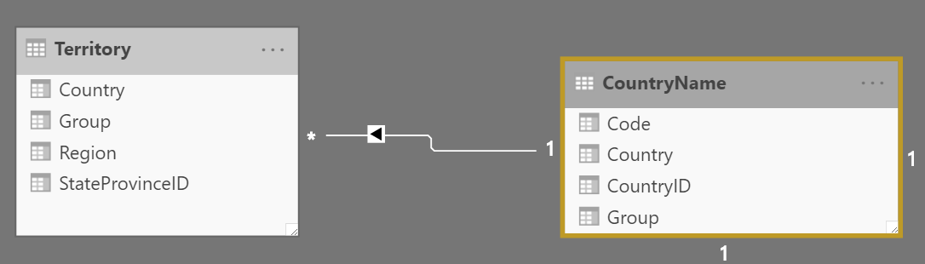
Relationships and Cardinality
Relationship: Formed by correlating rows belonging to different tables.
Cardinality: Uniqueness of data values in a column.
Notes:
Unlike other database management systems, Power BI has the concept of directionality to a relationship. This directionality, or cardinality, plays an important role in filtering data between multiple tables. When you load data, Power BI automatically looks for relationships that exist within the data by matching column names. You can also use Manage Relationships to edit these options manually.
The following are different types of cardinality that you'll find in Power BI.
Many-to-one (*:1) or one-to-many (1: *) cardinality:
Describes a relationship in which you have many instances of a value in one column that are related to only one unique corresponding instance in another column.
Describes the directionality between fact and dimension tables.
Is the most common type of directionality and is the Power BI default when you are automatically creating relationships.
An example of a one-to-many relationship would be between the CountryName and Territory tables, where you can have many territories that are associated with one unique country.
Cross-filter direction
Data can be filtered on one or both sides of a relationship.
Cardinality and cross-filter direction
For one-to-one relationships, the only option that is available is bi-directional cross-filtering.
For many-to-many relationships, you can choose to filter in a single direction or in both directions by using bi-directional cross-filtering.

Slide 13
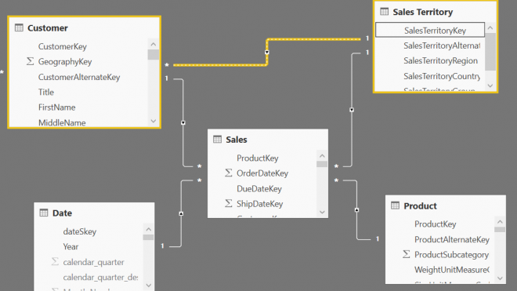
Modeling Challenges
Circular relationships and relational dependencies.
Notes:
Modeling data is about establishing and maintaining relationships so that you can effectively visualize the data in the form that your business requires. When you are creating these relationships, a common pitfall that you might encounter are circular relationships.
For example, you are developing reports for the Sales team and are examining the relationships between tables. In a poorly designed data model, Table 1 has a many-to-one relationship with a column in Table 2, but Table 2 has a one-to-many relationship with Table 3 that has its own relationship with Table 1. This web of relationships is difficult to manage and becomes a daunting task to build visuals because it is no longer clear what relationships exist. Therefore, it is important that you are able to identify circular relationships so that your data is usable.
Relationship dependencies
To understand circular relationships, you first need to understand dependencies.
For example, consider that you have the following calculated column Total in the Sales table.
Sales[‘TotalCost] = Sales[‘Quantity’] * Sales[‘Price’]
TotalCost depends on Quantity and Price, so if a change occurs in either quantity or price, a change will occur in TotalCost as well. This example outlines a dependency of a column on other columns, but you can also have dependencies between measures, tables, and relationships.
Consider the following relationships between dSalesPerson, fSales, and dCustomer. A change in dCustomer will result in a change in fSales, which results in changes in dSalesPerson. These types of dependencies can exist within relationships.

Slide 14
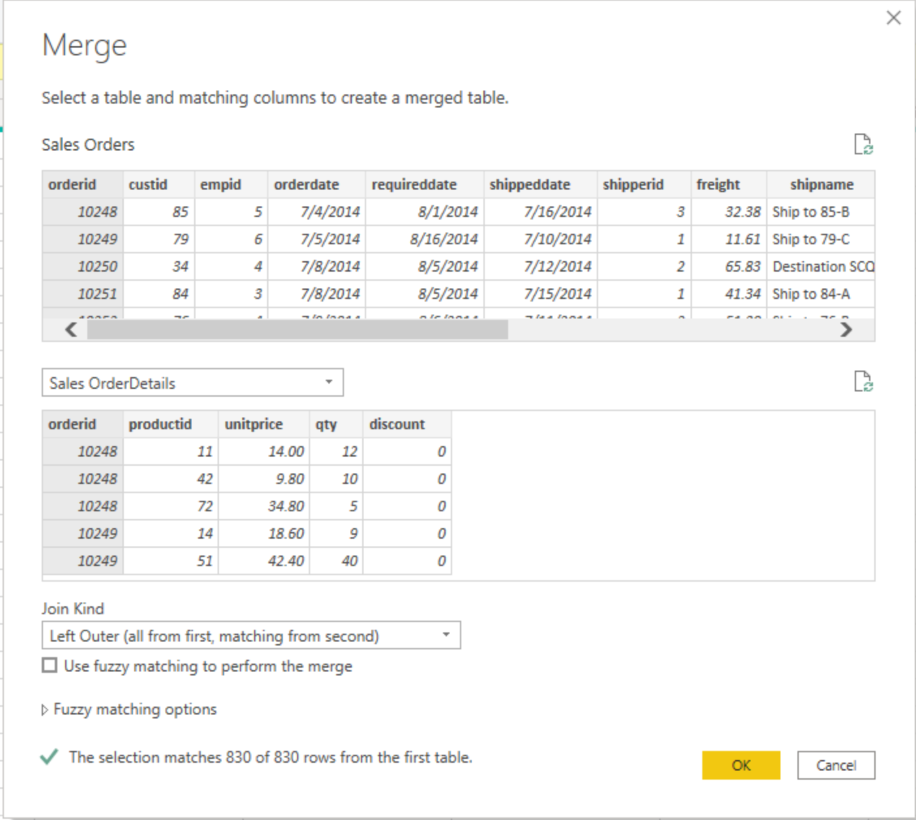
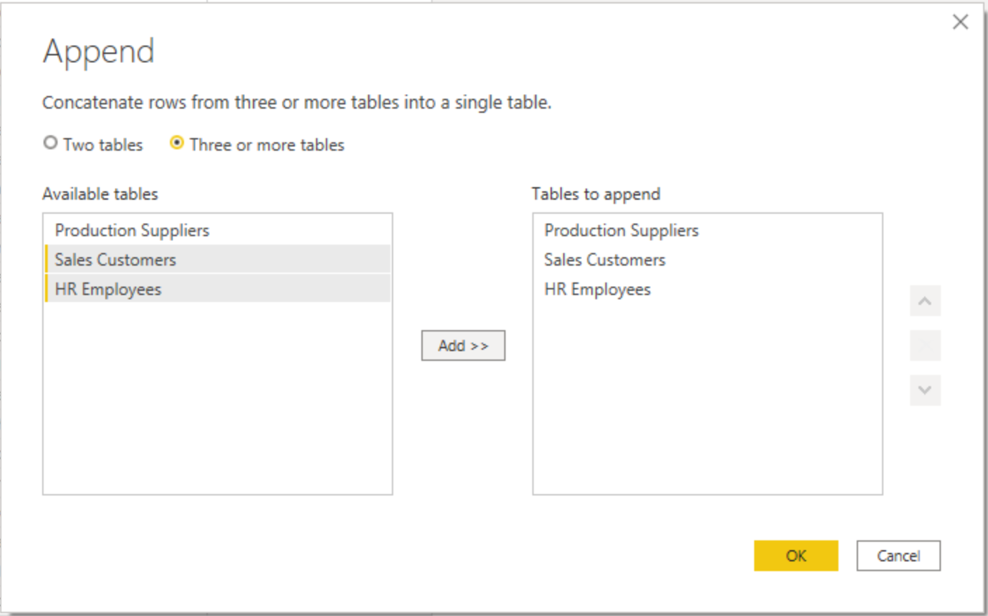
Combine Queries
Two methods for combining queries:
Append
Merge
Notes:
The ability to combine queries is powerful because it allows you to append or merge different tables or queries together. You can combine tables into a single table in the following circumstances:
Too many tables exist, making it difficult to navigate an overly-complicated data model.
Several tables have a similar role.
A table has only a column or two that can fit into a different table.
You want to use several columns from different tables in a custom column.
You can combine queries in two different way: Merging and Appending.
<Click>
Append:
When you append queries, you will be adding rows of data to another table or query. For example, you could have two tables, one with 300 rows and another with 100 rows, and when you append queries, you will end up with 400 rows.
Append queries will NOT remove duplicates.
If the columns in the source queries are not exactly matched: Append requires columns to be exactly similar to work in the best condition. if columns in source queries are different, append still works, but will create one column in the output per each new column, if one of the sources doesn’t have that column the cell value of that column for those rows will be null.
<CLICK>
Merge:
When you merge queries, you are combining the data from multiple tables into one based on a column that is common between the tables. This process is similar to the JOIN clause in SQL. Essentially, you will be adding columns from one table (or query) into another. To merge two tables, you must have a column that is the key between the two tables.
You can also choose how to join the two tables together, a process that is also similar to JOIN statements in SQL. These join options include:
Left Outer - Displays all rows from the first table and only the matching rows from the second.
Full Outer - Displays all rows from both tables.
Inner - Displays the matched rows between the two tables.

Slide 15
Review Questions (1)
Q01 – What is Cardinality?
A01 – Cardinality is a term that is used to describe the uniqueness of the values in a column. Relationship cardinality refers to the number of rows from one table that are related to another (one to one, one to many, many to many).

Slide 16
Lesson 3: Dimensions and Hierarchies

Slide 17
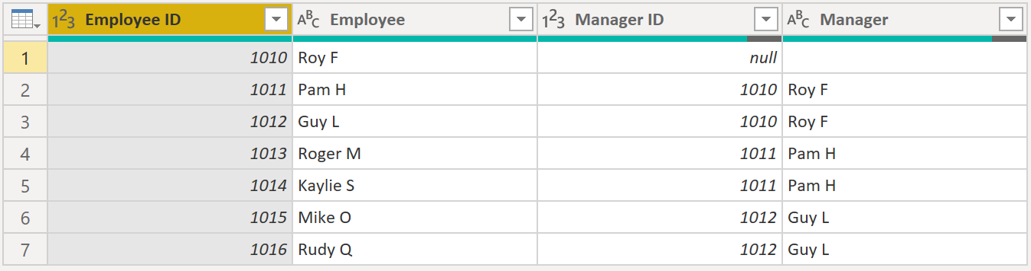
Introduction to Dimensions and Hierarchies
Dimension: Store details about business entities.
Hierarchy: Organize data such that one element is ranged over other data.
Notes:
When building a star schema, you will have dimension and fact tables. Fact tables contain information about events such as sales orders, shipping dates, resellers, and suppliers. Dimension tables store details about business entities, such as products or time, and are connected back to fact tables through a relationship.
You can use hierarchies as one source to help you find detail in dimension tables. These hierarchies form through natural segments in your data. For instance, you can have a hierarchy of dates in which your dates can be segmented into years, months, weeks, and days. Hierarchies are useful because they allow you to drill down into the specifics of your data instead of only seeing the data at a high level.
Parent-child hierarchy
Int this image, you have an Employee table within the database that tells you important information about the employees, their managers, and their IDs. When looking at this table, you notice that Roy F has been repeated multiple times in the Manager column. As the image shows, multiple employees can have the same manager, which indicates a hierarchy between managers and employees.

Slide 18
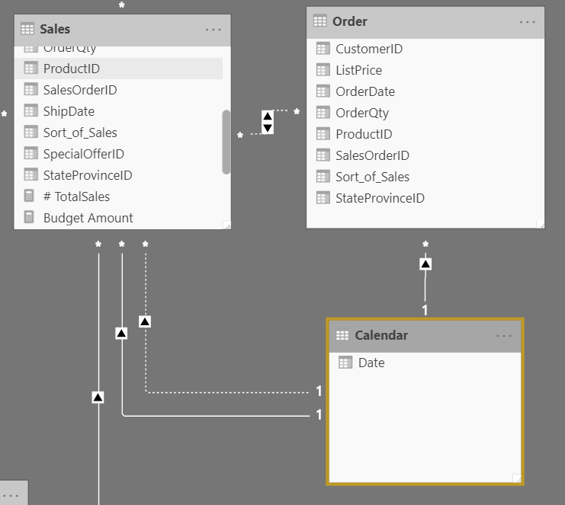
Role-playing Dimensions
A dimension that can filter related facts differently.
Notes:
A role-playing dimension is a dimension that can filter related facts differently.
For example, at Adventure Works, the date dimension table has three relationships to the reseller sales facts. The same dimension table can be used to filter the facts by order date, ship date, or delivery date.
Role-playing dimensions have multiple valid relationships with fact tables, meaning that the same dimension can be used to filter multiple columns or tables of data. As a result, you can filter data differently depending on what information you need to retrieve. This topic is complex, so it is only introduced in this section. Working with role-playing dimensions requires complex DAX functions that will be discussed in later sections.
This visual shows the Calendar, Sales, and Order tables. Calendar is the dimension table, while Sales and Order are fact tables. The dimension table has two relationships: one with Sales and one with Order. This example is of a role-playing dimension because the Calendar table can be used to group data in both Sales and Order. If you wanted to build a visual in which the Calendar table references the Order and the Sales tables, the Calendar table would act as a role-playing dimension.

Slide 19
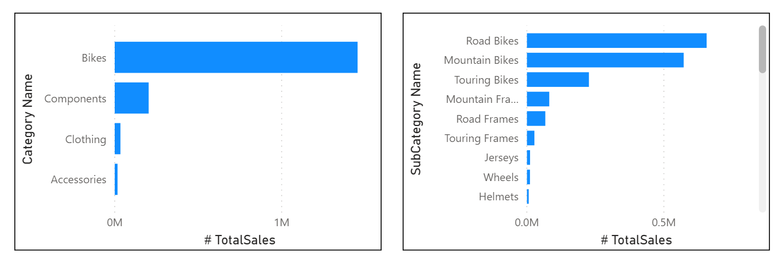
Creating new Hierarchies
Causes:
Notes:
Consider a situation where you want to create a stacked bar chart of Total Sales by Category and Subcategory. You can accomplish this task by creating a hierarchy in the Product table for categories and subcategories.
To create a hierarchy, go to the Fields pane on Power BI and then right-click the column that you want the hierarchy for. Select New hierarchy, as shown in the following figure.

Slide 20
Review Questions (2)
Q01 – A dimension that can filter related facts differently is called what?
A01 – A role-playing dimension.
Q02 – What type of table stores details about business entities?
A02 – Dimension table.

Slide 21
Lab: Model Data in Power BI Desktop
Lab: Model Data in Power BI Desktop

Slide 22
Module Overview
We covered the following concepts:
Data Modeling
Working with Tables
Dimensions and Hierarchies
Notes:
In this module we discussed:
How to model data appropriately
How to work with tables
What dimensions and hierarchies are

Slide 23

References
PL-300 Design a data model in Power BI
https://docs.microsoft.com/en-us/learn/modules/design-model-power-bi/
Notes:
It is good practice to tie back your ILT deliveries to role-based learning materials on Microsoft Learn. What is listed here should supplement your delivery and the role-based training your course is affiliated with. It is important to give the learners continued education opportunities for growth.
Steps:
1. Insert the page title here along with the url to other Microsoft resources
2. It is only necessary to duplicate this slide if there are more than 6 references that need to be shared with the students.

